Slide 1
HISTORY & EVOLUTION OF REPERTORY
Dr.V.SATHISH KUMAR, M.D (Hom)
HOD and Professor, Department of Repertory
Sarada Krishna Homoeopathic Medical College
Kulasekharam

Slide 2
History & Evolution
Dr.Hahnemann proved more than 90
drugs and recorded, but he himself
couldn’t prescribe without referring
to it, which was time consuming and
laborious task. So he himself felt
the need of indexing of symptoms.

Slide 3
Therefore, he conceived the idea of indexing the Materia Medica logically, which can help a practitioner to find the needed symptoms along with all the corresponding medicines.
Such an index can help a physician to find a medicine. Which covers the maximum symptoms of the patients.

Slide 4
This helped the emergence of concept of repertorization. Actually, the various concepts, nature of homoeopathy, and principle of individualization itself made the way for emergence of discipline of repertory.

Slide 5
He tried to introduce idea to compile repertory of some of the leading symptoms in 1805 in his first Materia Medica, printed in Latin known as “Fragmenta De Viribus Medicamentorum Positivis Sive In Sano corpore Humano Observatis.”
The first part contained symptoms observed and the second part formed index or repertory.

Slide 6
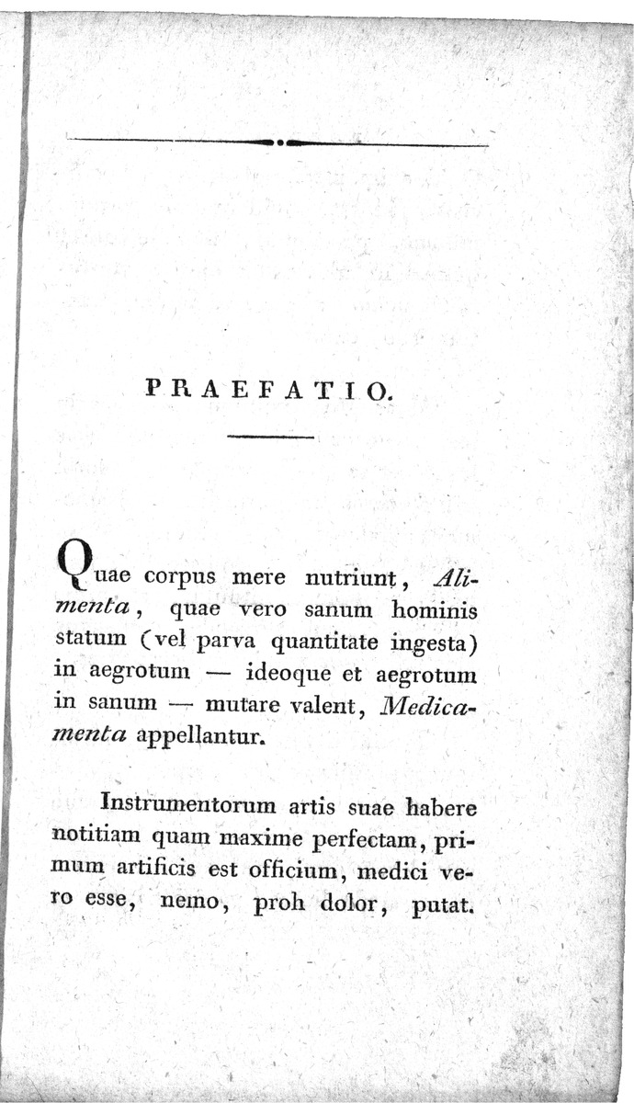

Slide 7
Dr. Hahnemann compiled, hand
written 4 volumes of repertory to use
in his daily practice, consisting of
4239 pages with slits to hold, in 1817.
Which never appeared in printed form.

Slide 8
Hahnemann writes to Boenninghausen
June 20th,1830 :
“The repertory which was
announced without my approval
is ready, but as I have been on
friendly terms with Arnold for
20 years , I can not look
for another publisher. ”
Life History Of Hahnemann,
Richard Haehl , M.D., vol.-II ,
pg. no - 263 , supplement - 124.

Slide 9
Hahnemann words (contd…)
Jan 16th,1831
“My repertory was an alphabetical
record, which could only be of great
service in looking up the necessary
symptoms of medicine, if very
complete, and this perfection
is not yet to be found in mine.
It is therefore not to be regretted
that it remains unpublished. ”
Life History Of Hahnemann ,
Richard Haehl , M.D. ,
Vol.-II , pg. no - 263 , supplement - 124.

Slide 10
Hahnemann words(contd…)
Nov 25th,1833 :
A dictionary of symptoms
would occupy an efficient
and very industrious assistant
secretary, uninterruptedly
for a whole year.
Life History Of Hahnemann,
Richard Haehl, M.D. ,
Vol.-II, pg. no - 264, supplement - 124.

Slide 11
Hahnemann words (contd…)
Aug 21st,1834 :
If god permits, Jahr will workout
the Symptom dictionary, and
I shall contribute what I can.
He is gifted for it, and has
unswerving diligence. I think that
it will have to be printed as one
large octavo dictionary , like
cramer’s dictionary printed
by view. It will be an immense but
valuable work.
Life History Of Hahnemann ,
Richard Haehl , M.D. ,
Vol.-II , pg. no - 264 , supplement - 124.

Slide 12
Hahnemann words (contd…)
Dec 25th , 1834 :
“If homoeopaths become aware
that the repertories are
insufficient for the finding of the
best remedy in every case of disease,
nevertheless they feel secure when
they have such a key in hand and
calm their minds with the reflection
that “ with some probability”
Life History Of Hahnemann ,
Richard Haehl M.D.,
Vol.-II , pg. no - 379 , supplement - 183.

Slide 13
ORIGIN OF THE CONCEPT OF REPERTORIZATION

Slide 14
Hahnemann in his Organon has mentioned in aphorism 153 the importance of characteristics symptoms and suggested in the footnote of the same aphorism that the characteristic symptoms should be referred to the repertories for finding out an appropriate remedy for the case.
In Materia Medica Pura he demonstrated the working of two cases which gave some idea about his concept of repertorization.

Slide 15
Idea of repertory grew further
Dr.Gross and Dr.Ruckert compiled a repertory under Hahnemann’s own supervision from 1822 - 1830.
It was intended as a fifth volume to chronic diseases , but never appeared in print .
Dr. Gross’s work is in 2 volumes in his own hand writing and Dr. Ruckert’s work is known as the Register of symptoms.

Slide 16
These volumes are masterpieces & can be seen in the institute for the history of medicine of the Robert bosch foundation, Stuttgart.
Hahnemann employed Dr.Jahr to complete the 2nd edition of the chronic disease and also to lay foundation of a repertory and encyclopedia of symptoms.

Slide 17
Jahr published his first repertory in 1835. The 2nd edition was in German language in 2 volumes containing 1052 & 1254 pages, followed by 3rd repertory on glands, bones, mucous membranes, ducts, skin diseases.
Technically Hahnemann was the first repertorian yet the credit for publishing the first repertory goes to Boenninghausen.

Slide 18
BOENNINGHAUSEN’S ERA
Finally Boenninghausen made a serious attempt in this direction under Hahnemann’s instruction.
His pioneering work published in 1832 was not only successful, but it became a progenitor of all the later repertories.

Slide 19
References
A reference to repertories for homoeopathic students-DR. SIJU .P.V
Essentials of repertorisation-DR.SHASHI KANT TIWARI
Fragmenta De Viribus Medicamentorum Positivis Sive In Sano corpore Humano Observatis.
Organon of Medicine –Dr.Samuel Hahnemann
Life History Of Hahnemann, Richard Haehl.
Repertory of Hering’s Guiding symptoms of Materia Medica-jahr repertory.

Slide 20
THANK YOU

